Slide 1
Change control and regulatory documentation
Navigation and access

Slide 2
Regulatory support documentation
is an invaluable starting point for process development and validation. It is also critical for preparing standard operating procedures (SOPs), quality control, and for supporting clinical and marketing applications to regulatory agencies.

Slide 3
Presentation overview and quick links
Two separate online systems
  Cytiva’s regulatory support documentation – summary
Accessing extractables information
Locating your lot-specific product certificate
Log in to the regulatory support website
  Start your subscription
  View your active subscriptions
E-mail notifications
Register and log in to the
Accelerator™ documentation center
  Help for the Accelerator
  documentation center
  Document module
  Drawing module
  Claims and compliance reports

Slide 4
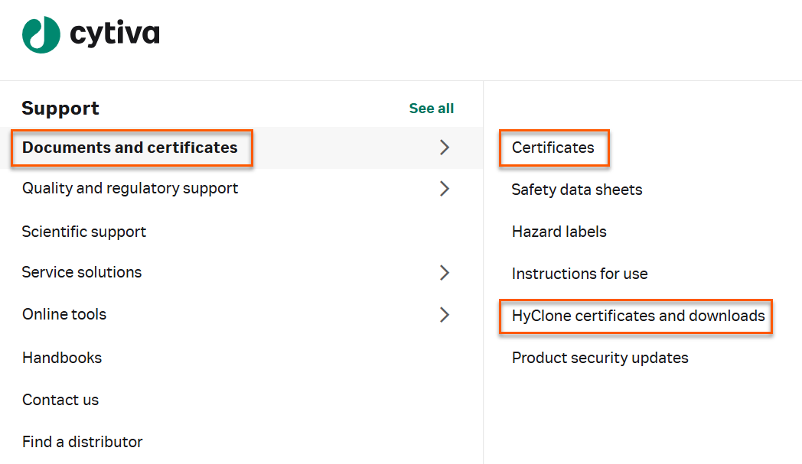
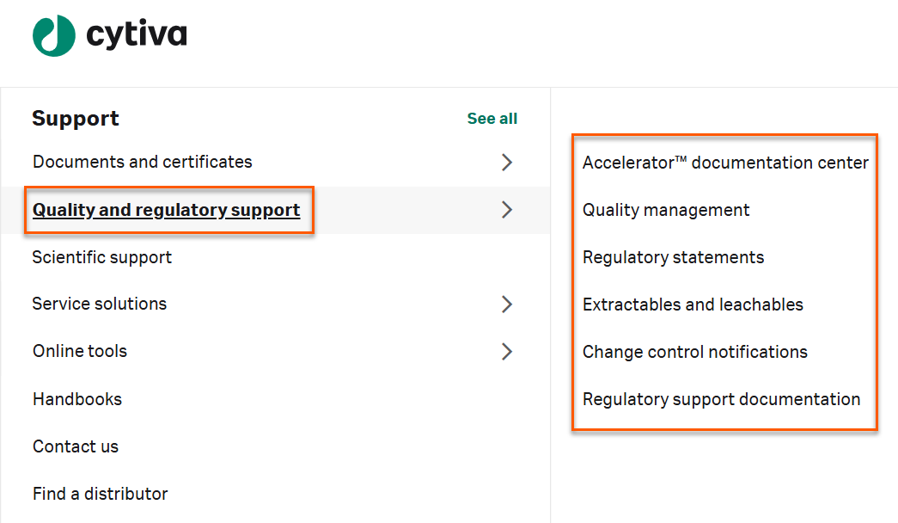
Navigating cytiva.com
www.cytiva.com/certificates
www.cytiva.com/rsf

Slide 5
Quality and Regulatory Support
With regulatory support accounts—available to Cytiva customers—you gain access to product documentation useful for process development and validation. The documentation is free of charge and is critical for preparing standard operating procedures (SOPs), quality control, and clinical and marketing applications for submission to regulatory agencies.
We offer change control notification (CCN), regulatory support files (RSF) for chromatography resins and cell culture media, validation guides (VG) for single-use products and bioprocess filters, validation support files (VSF) for software, and extractables information (EI) for supported products.
Regulatory documentation is provided via two separate online systems: Regulatory support and Accelerator documentation center.
Our subscription service notifies you when updated regulatory documents are available.

Slide 6
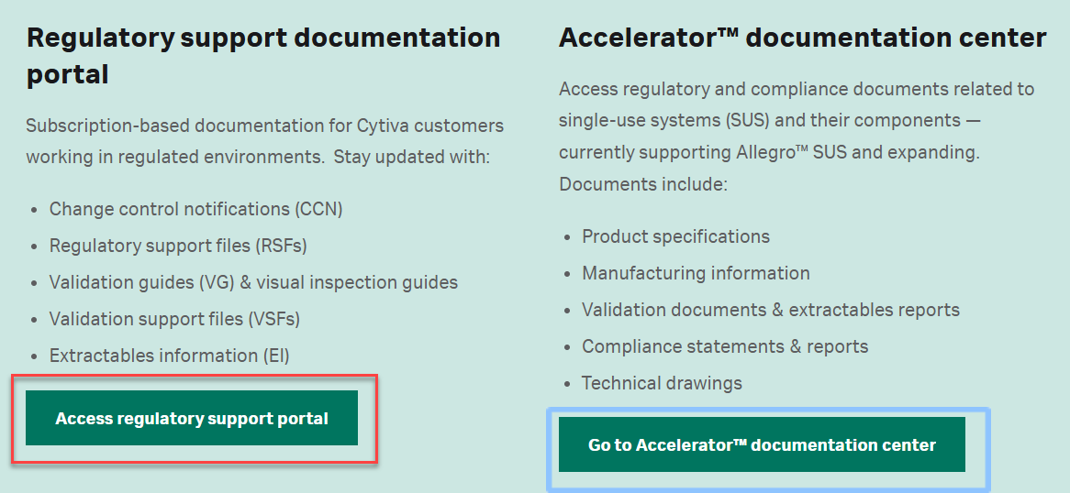
Two separate online systems
With different documents and different logins
1
cytiva.com/rsf
Login: Cytiva web account required
cytiva.com/adc
Login: Separate account required
2

Slide 7
Cytiva’s regulatory support documentation – summary
Access via subscription with login + online CDA
Accelerator documentation
center with login
Access without login
Access with login
On request only
Quality management
documents
Regulatory statements
Extractables
testing/approach
Global site certificates
such as ISO certificates
Change control notifications (CCN) by subscription
Regulatory support documentation
by subscription
Regulatory support files, validation guides, and validation support files
Extractables reports
Visual inspection libraries
Documents related to single-use systems (SUS) and their components — currently supporting Allegro™ SUS and expanding.
Drawings and bill of materials (BOMs)
Compliance documents and The claims and compliance report
Validation documents and technical reports
Extractables reports
Visual inspection library
Drawings and BOMs
for products not in the Accelerator documentation center
Qualification packages
(for products not in
the Accelerator documentation center)
Chain of custody
Note: Regulatory support and Accelerator documentation center require two separate login accounts.
*May require NDA to access some documents.

Slide 8
Key available quality management documents
All documents on the right
are readily available on the Cytiva web without creating
an account.
Quality policy
Cytiva Rx-360 general quality systems
- Questionnaire responses
Quality management system
Standard for Cytiva change control and notification process
for designated products
Cytiva change control and notification process
for Pall Medical products

Slide 9
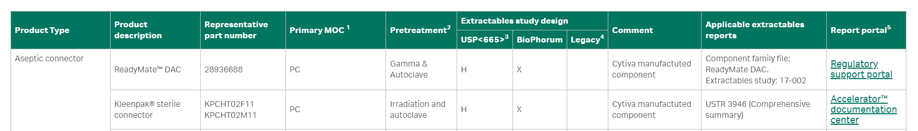
Accessing extractables information
Discover our approach to extractables and leachables testing on our website. https://www.cytivalifesciences.com/en/ussupport/quality-and-regulatory-support/extractables-and-leachables
The actual information and reports are accessible on our two websites:
Accelerator documentation center (Allegro single-use systems and associated filters and aseptic connectors)
Regulatory support website (for all other product groups)
The webpage above guides you on where to locate extractables information and reports based on product type.

Slide 10
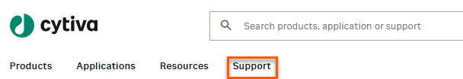
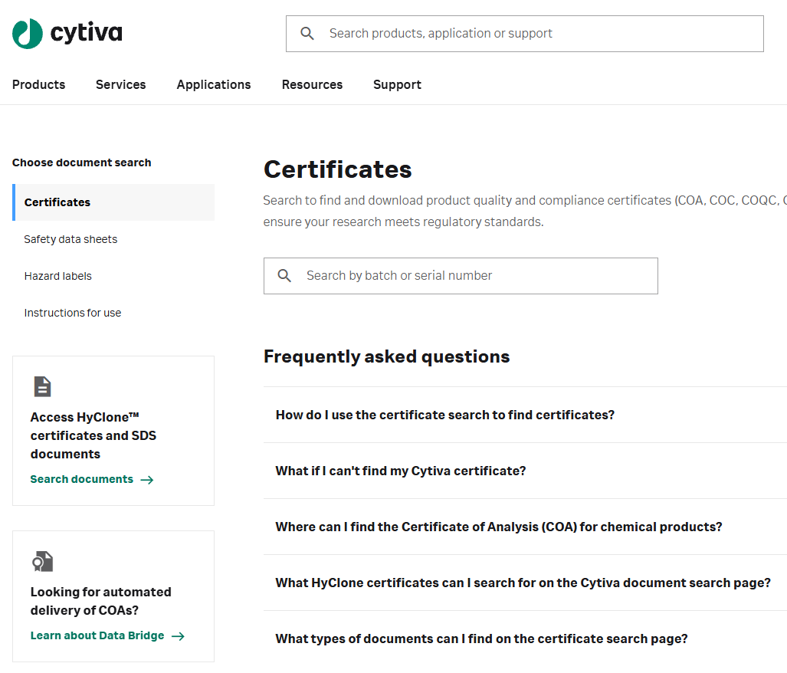
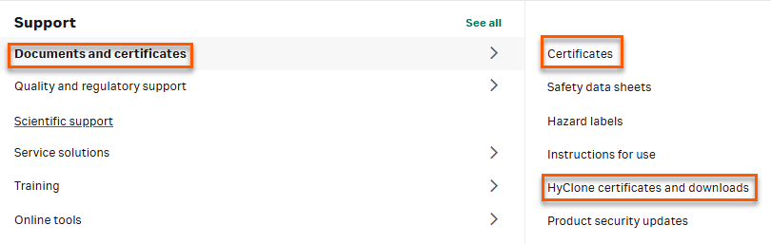
Locating your lot-specific product certificate
www.cytiva.com/certs
Search by batch or serial number
Additional link for Hyclone™

Slide 11
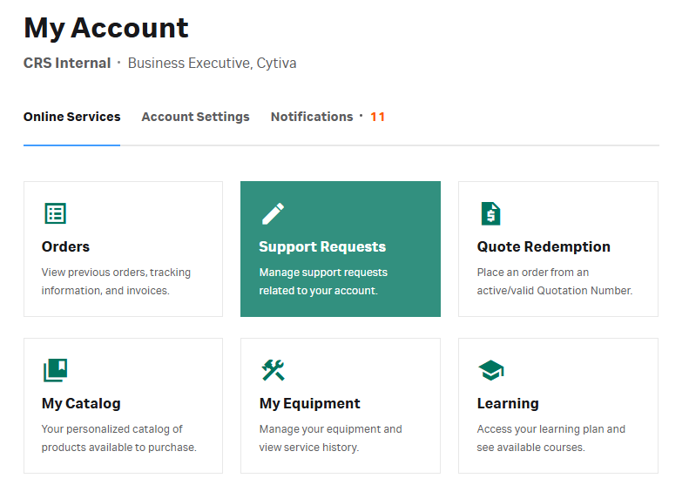
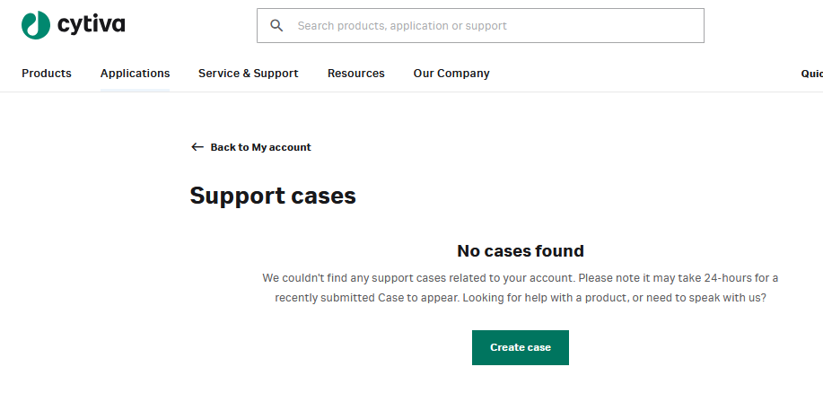
Regulatory support documentation: on request only
1. Go to www.cytiva.com/account
2. Select ‘Support requests’
3. Create case
4. Follow the Help & Support prompt for:
Invoice query
Order status
Price and availability
Scientific support
For inquiries or requests not addressed by the Cytiva information platforms
You can also create cases by emailing your regional support team.

Slide 12
Regulatory support
1

Slide 13
Change control notification (CCN) service
Our quality management system ensures our processes adapt to change.
The service covers the following products used in regulated environments: bioprocess hardware, software, single-use disposables, filtration products, chromatography resins, cell culture products, cell and gene therapy products, and Biacore™ products.
Our web-based change control notification service alerts you to changes that may impact your product or process.
What the CCN service offers:
  Email notifications when a new CCN is published
  Access to history of all previously published CCNs for a specific product
  Download files in pdf format

Slide 14
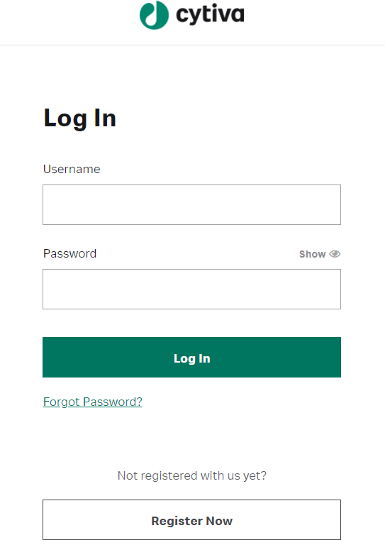
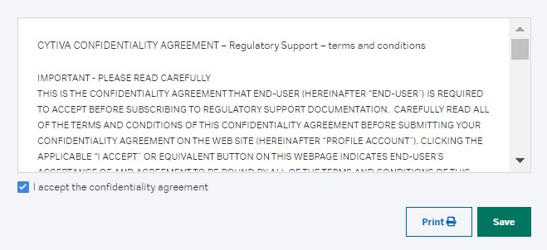
Log in to the regulatory support website
If you already have a cytiva.com account, log in to www.cytiva.com/rsf, with your e-mail address and password.
If you do not have an account, click ‘Register now’ and follow the instructions to create one.
Please remember to register with your company
e-mail address.
Consider using a shared mailbox when subscribing to change control notifications (CCNs) to minimize communication gaps that can arise from personnel changes.
If you wish to access confidential files, i.e., validation guides, extractables studies, etc., you can accept the online CDA during registration. Otherwise, you will be prompted when you request access to these documents.

Slide 15
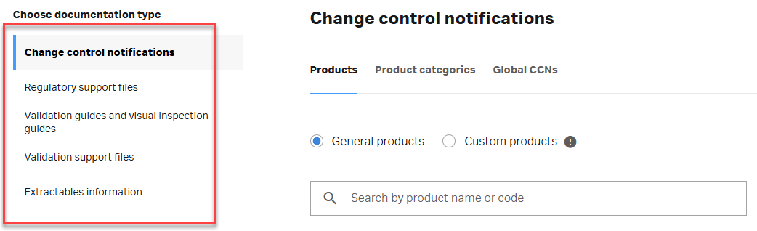
Start your subscription
After logging in to www.cytiva.com/rsf, you will be redirected to
Regulatory documentation where you can search and subscribe.
Select the document type you want to subscribe to by navigating the options to your right.

Slide 16
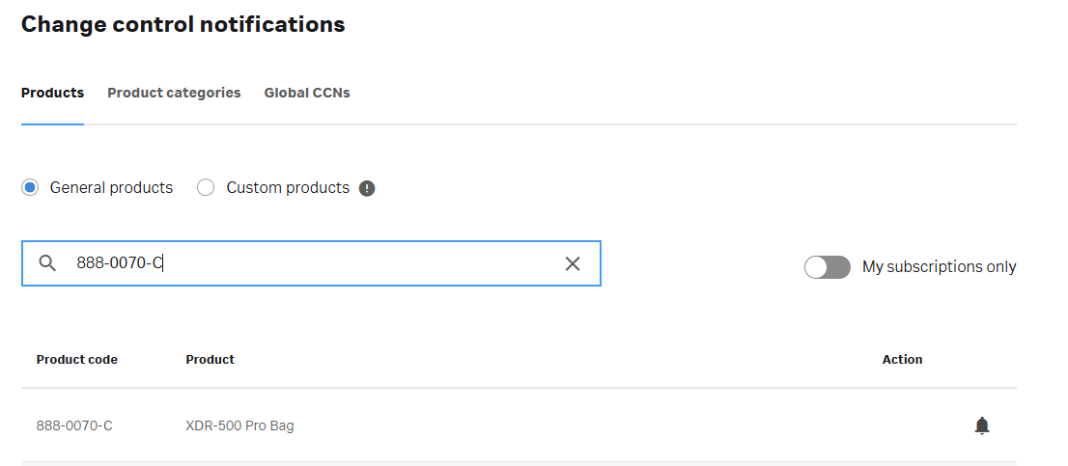
Subscribe to change control notifications (CCNs)
For equipment and software, switch tab and search by category here.
Search for a product code
(e.g., 888-0070-C) to generate
a list of search results.
For custom products, ensure this box is checked.
For custom Hyclone products, please email:
changenotice@cytiva.com
Click the bell icon to subscribe to a product in the search results.
Note: Customers should subscribe to both equipment and consumables separately.
For ReadyToProcess™ columns packed with resins, both column and resin require subscriptions.
Notes:
Address custom CCNs here. Include custom Hyclone @changenotice@cytiva.com

Slide 17
Subscribe to change control notifications (CCNs)
Search for a product code
(e.g., 888-0070-C) to generate a list of search results.
Click the bell icon to subscribe to a product in the search results.
For equipment and software, switch tab and search by category.
For custom products, ensure Custom products is selected.
For custom Hyclone products, please email:
changenotice@cytiva.com
3
4
1
2
Note: Customers should subscribe to both equipment and consumables separately.
For ReadyToProcess™ columns packed with resins, both column and resin require subscriptions.
Notes:
Address custom CCNs here. Include custom Hyclone @changenotice@cytiva.com

Slide 18
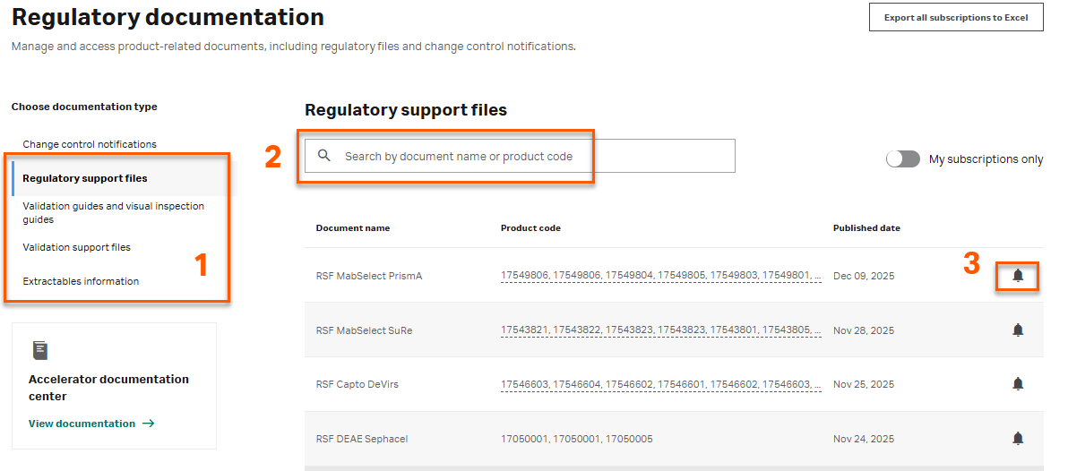
Subscribe to confidential regulatory support documentation
When you subscribe to confidential regulatory support documentation for the first time, our support team will review and approve your request—usually within two business days. While your request is under review, you'll see an online notification, and you’ll receive an email once you’re approved.
After first approval, you can access most regulatory support documents immediately after adding them.
Note: Some subscriptions require an extra approval step due to the sensitivity of the information. If this applies to your request, you'll be notified online. Our support team will handle the additional review, and you'll receive a confirmation email once it's complete.
Select document type
Search for the product in question
Press the bell icon to add it to your subscriptions

Slide 19
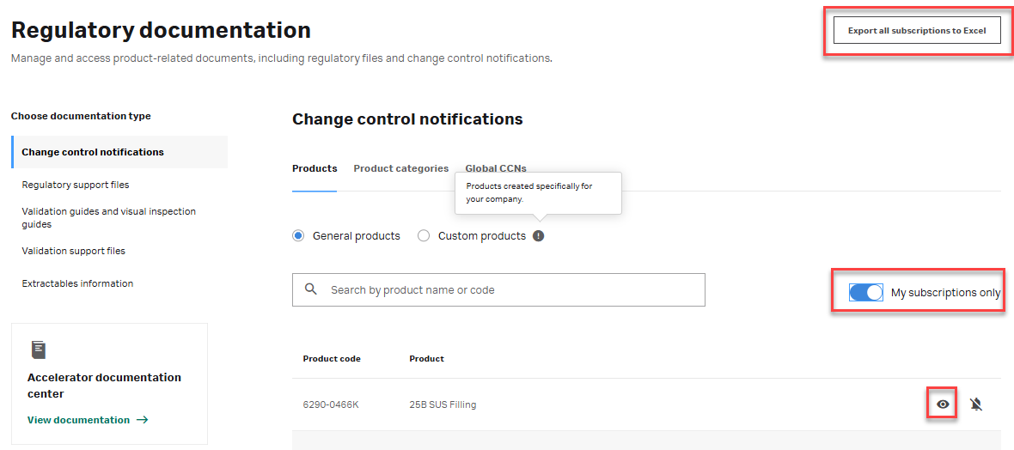
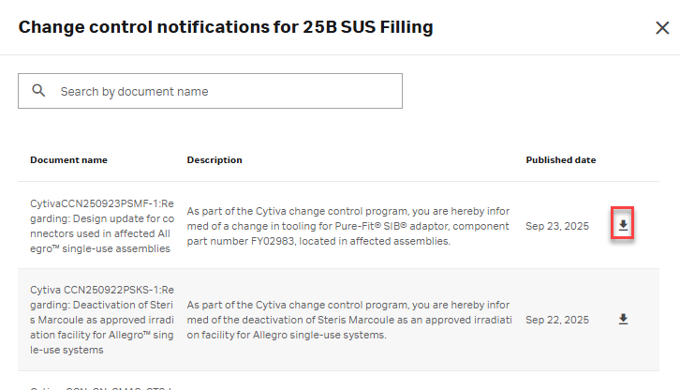
View your active subscriptions for change control notifications
Select documentation type
‘Change control notifications’
and makes sure you also activate
'My subscriptions only’.
Select the part number of interest.
Press the eye icon and a pop-up window will show you all related CCNs published.
From this page you can also unsubscribe to any product/CCN category by pressing the crossed over bell icon.
You can also export a list of your current subscriptions.​

Slide 20
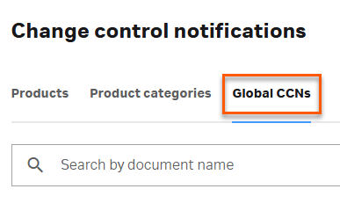
View your active subscriptions for change control notifications
Global CCNs impact all products, and you are automatically subscribed to global CCNs upon subscription to any product.
You will find these under the tab ‘Global CCNs’

Slide 21
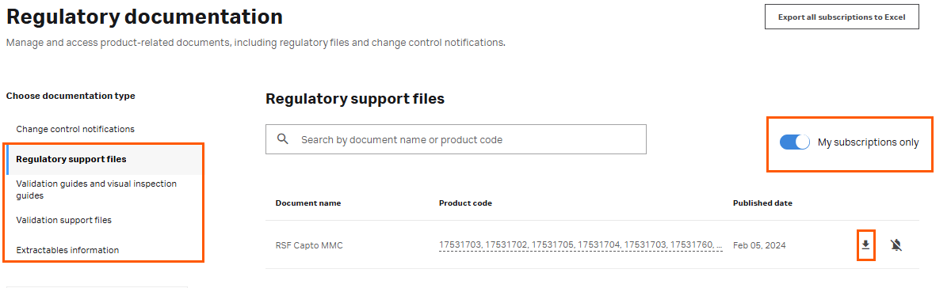
View your active subscriptions for regulatory support documentation
Select documentation type e.g. ‘Regulatory support files’
Makes sure you activate
'My subscriptions only’.
Press the download button.
From this page you can also unsubscribe to any document by pressing the crossed-out bell icon.

Slide 22
E-mail notifications
Change control notifications
You will receive a single e-mail when a CCN
is published to your product subscription, even if the CCN covers multiple products. Each e-mail lists all the affected products that you subscribe to.
Regulatory support documentation
You will receive an e-mail when a document that you subscribe to is updated.
We recommend that you retain your notification email with the CCN for your records.

Slide 23
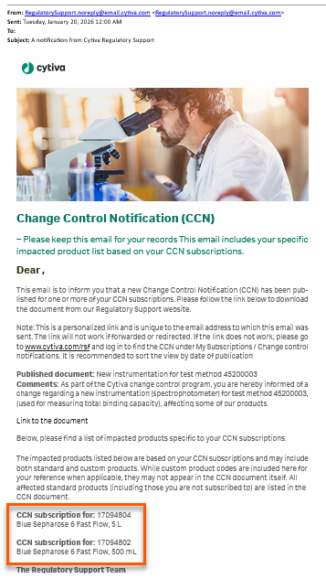
E-mail notifications: How to read your CCN email
The registered subscriber receives our email.
You must be logged in as the subscriber to access the document. Once downloaded, the CCN can be distributed internally.
This section shows which of the products you subscribe to are affected by the change.
We recommend keeping this email with the CCN for your records.
Click on this link to open the change control notification document.

Slide 24
Accelerator documentation center
2

Slide 25
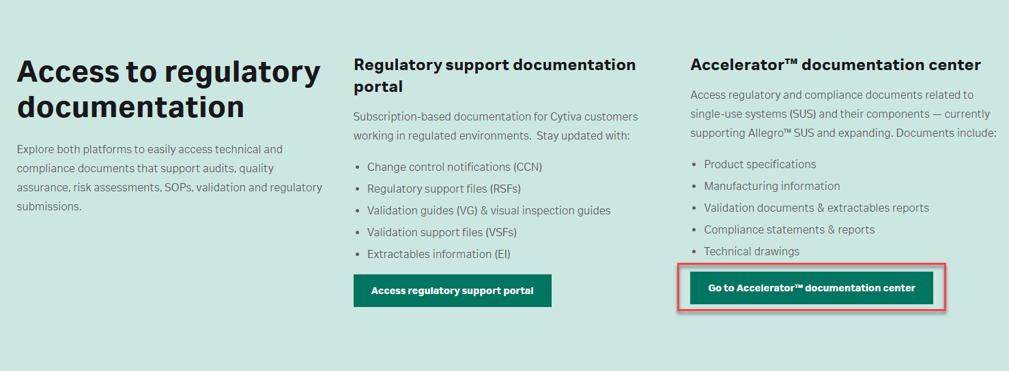
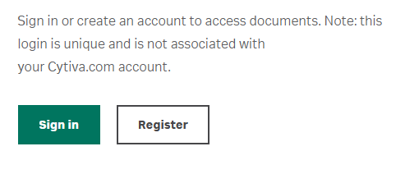
Accelerator documentation center

Slide 26
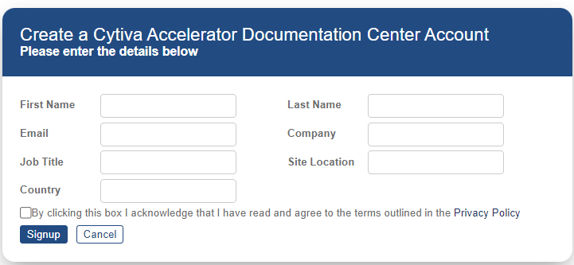
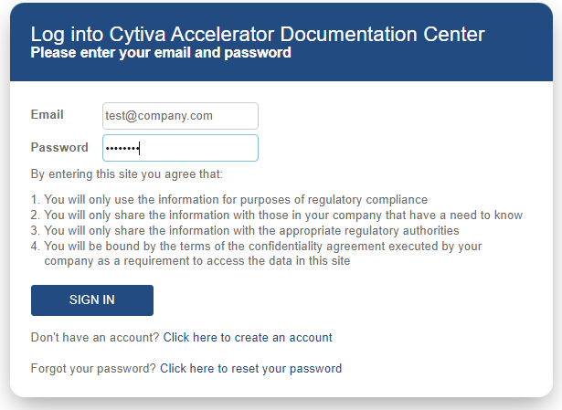
Register and log in to the Accelerator documentation center
If you already have an account, log in to cytiva.com/adc, with your e-mail address
and password.
If you do not have an account, click ‘Register’ and follow the instructions to create one. This platform does not allow shared user accounts.
Once the account is approved, click ‘Sign in’.
We recommend using Google Chrome to access the Accelerator documentation center.
Note: Regulatory support and Accelerator documentation center require two separate login accounts.

Slide 27
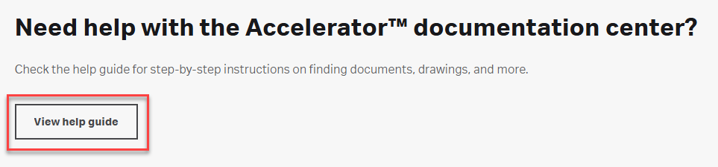
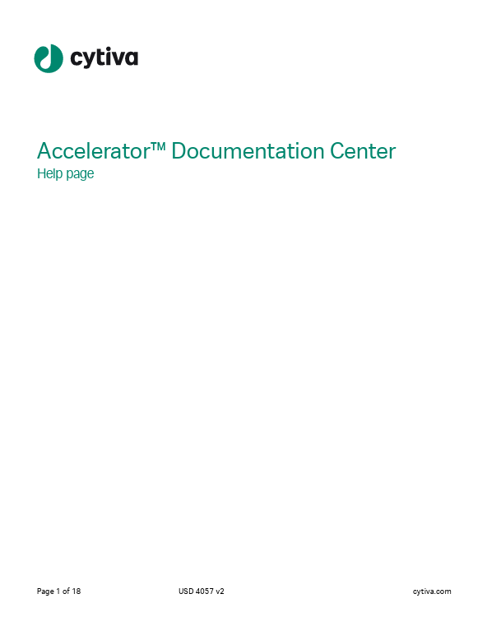
Help for the Accelerator documentation center
Under the Accelerator documentation center
sign in and registration page, you will find an extensive help guide.
This guide provides detailed information around
the extractable documents, document categories,
and drawings that are in the Accelerator documentation center.

Slide 28
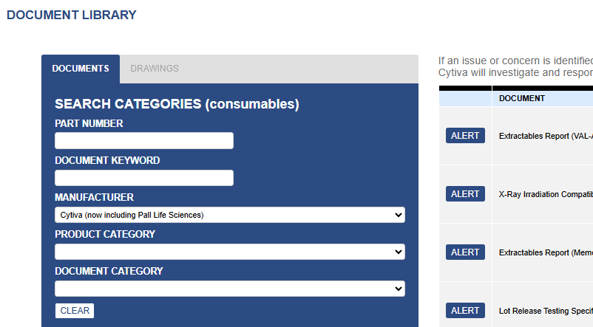
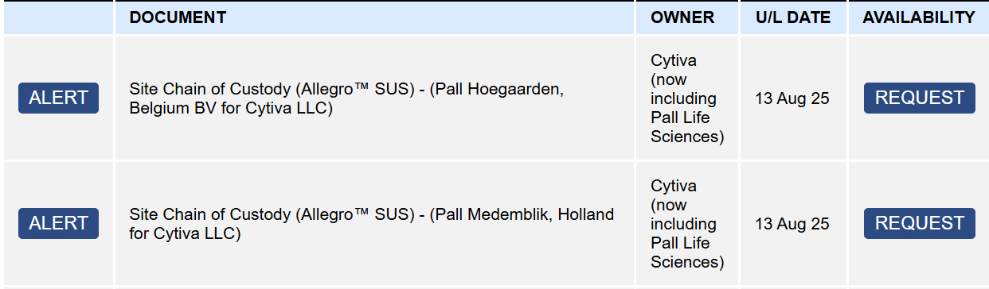
Document module in the Accelerator documentation center
Once logged in to the Accelerator documentation center, you’ll have multiple ways to access the information:
Searching by component ‘Part number’ displays the component’s status, the description, and the manufacturer.
Searching by ‘Manufacturer’ displays the available supplier documents.
Searching by ‘Document keyword’ lets you search using exact matches from document names.
Refine results by product category or document category
(or sub-category) e.g., extractable reports.
After entering your search criteria, the availability column will show either ‘View’ or ‘’ for documents you can access. Download.
For confidential or third-party documents, ‘Request’ will appear—this initiates the NDA process.
Notes:
So this is what the Accelerator documentation center looks like, note here there are two modules available named ‘documents’ and ‘drawings’
In the document module, there are several search categories on the left hand side which are used to locate specific documents. Once a search filter has been entered, you can view the document name and view/download the document on the right hand side as applicable.
A full list of document types can be found on the Accelerator documentation center help page which will help searching for specific document types.

Slide 29
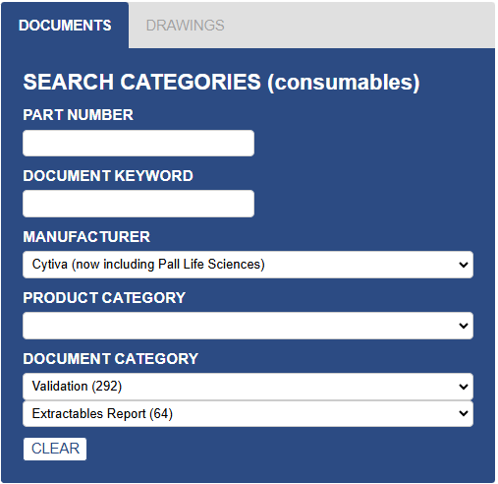
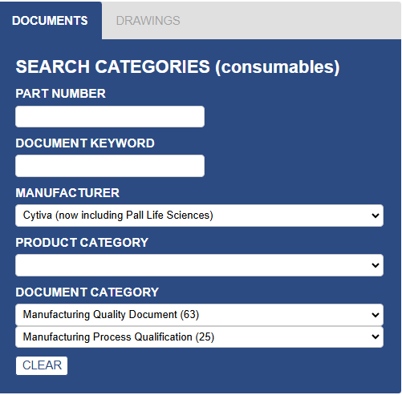
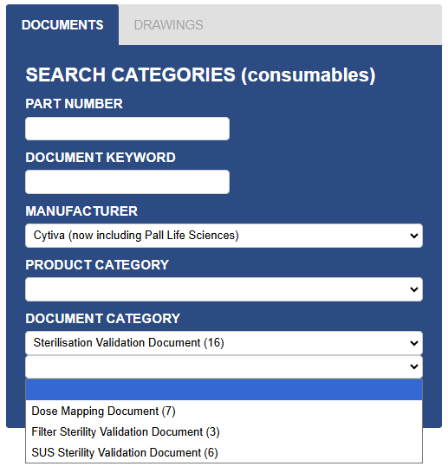
Common document searches
How to find extractable reports,
if you do not have a specific ref.
How to find qualification reports for CCN, if you do not have a specific ref.
How to find sterilization reports and sterilization sites, if you do not have a specific ref.
Another optional way to find CCN related extractable reports is available, please see the Help guide.

Slide 30
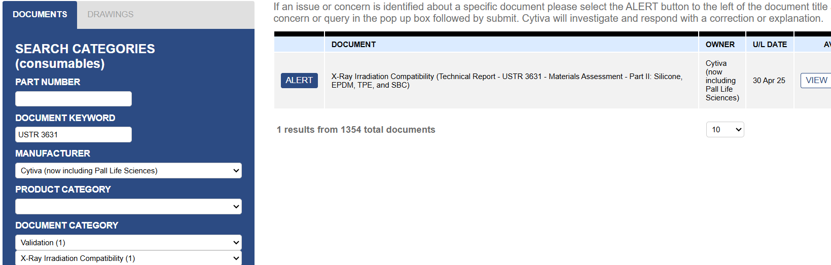
Document categories in the Accelerator documentation center
Use the document category dropdown to narrow your search.
Some document categories have sub-categories to help you refine your search further.
A table of categories and sub-categories is available in the help guide.
The number in brackets next to each category name indicates how many documents are available in each category.

Slide 31
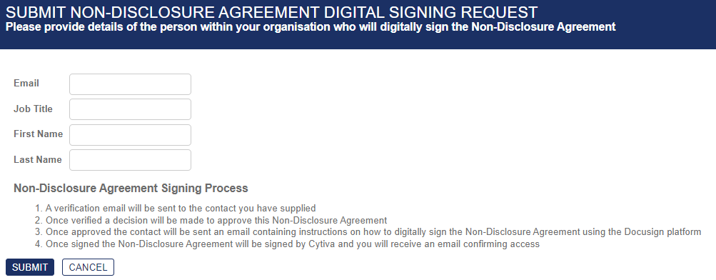
NDA request in the Accelerator documentation center
Begin the NDA signing process by selecting ‘Request’ against a confidential/third-party document. You should receive a response within three business days.
Assign someone with appropriate authorization to sign the NDA on behalf of your site.
Cytiva will process your request. Once the NDA is signed, you’ll be able to access confidential and third-party documentation within 48 hours.
Notes:
Nothing has changed for this process, except ‘Request’ option is now visible against third party documents also.

Slide 32
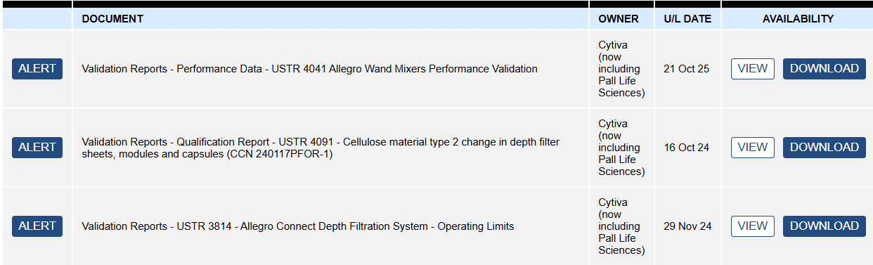
Document alert in the Accelerator documentation center
If an issue or concern is identified with a specific document, select ‘Alert’ against the relevant document, enter the concern or query and submit or if, you prefer to, email acms-doccontrol@cytiva.com
Cytiva will investigate and respond with a correction or explanation within three business days.
Notes:
For issues with documentation, customers or internal users can use the ALERT function within the Accelerator documentation center. or email Regulatory Document Control team directly. The email address is at the bottom of the screen here.
To submit an alert, select ‘alert’ against the required documentation, enter your query and the team will get back to you within 3 days.

Slide 33
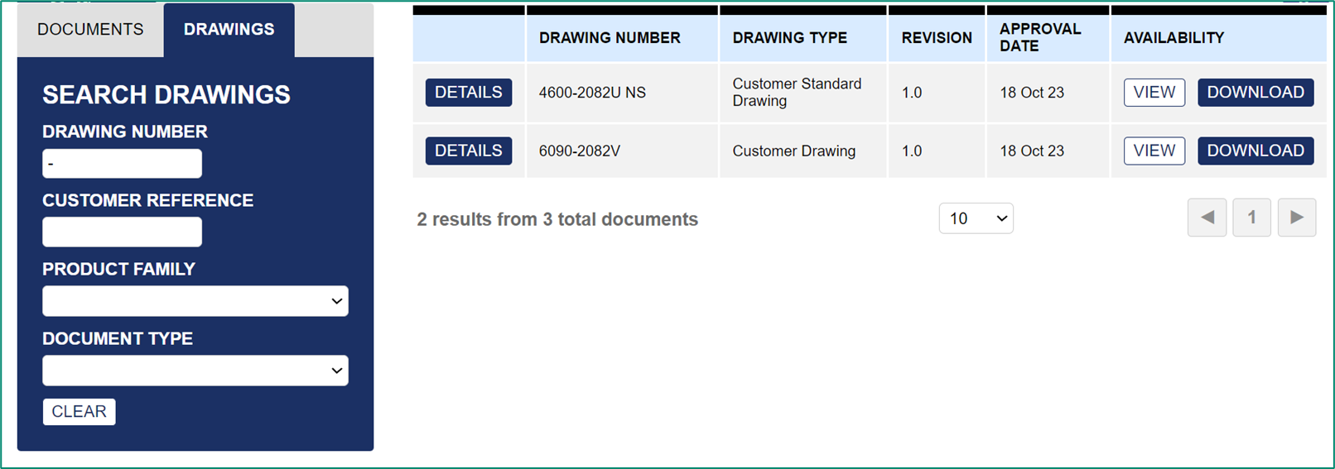
Drawing module in the Accelerator documentation center
To search the drawings list, enter your drawing number or customer reference.
To view all drawings, enter a hyphen (–).
Please note: An NDA is required to access the drawing module.
You can refine your results by selecting a product family or drawing type—
either customer drawings or customer standard drawings.
Drawings and drawing documents available are:
Latest version of approved drawings only.
English versions only.
Your own designated sites’ drawings.
Drawings ‘shared’ with your designated site.

Slide 34
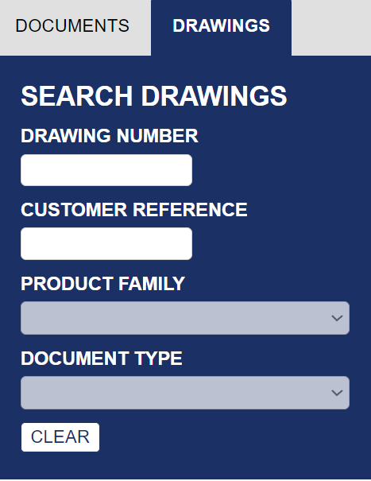
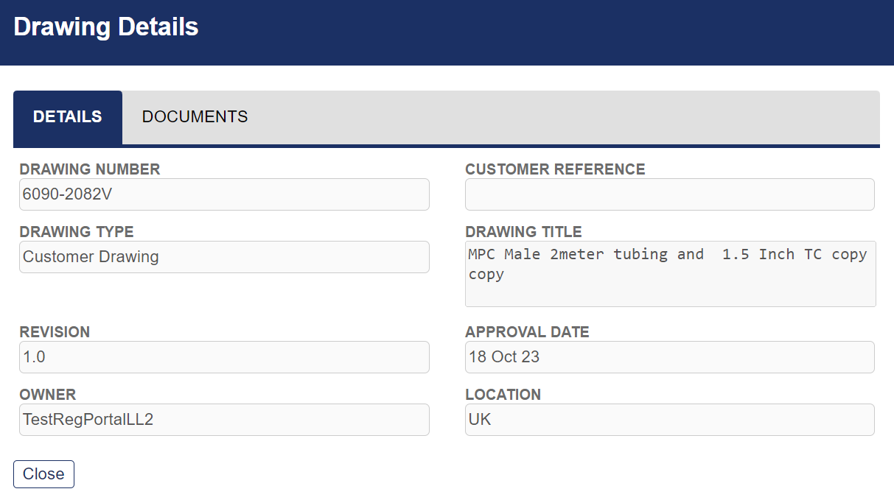
Drawing module in the Accelerator documentation center – customer references
You can request to add your own references to each design. Once added by your Cytiva sales/account manager, you can use these references to search for your drawings after
24 hours of the change.
We can add customer drawing references without revision to the design.
You can view your customer reference on the drawing details page.

Slide 35
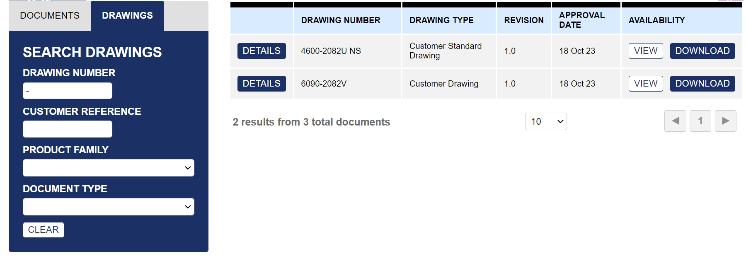
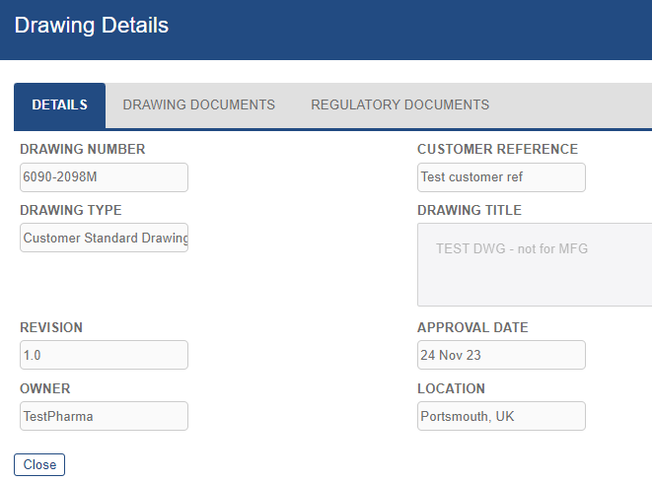
Drawing module in the Accelerator documentation center –drawing details
Select ‘details’ against a drawing to access full drawing data and documentation.

Slide 36
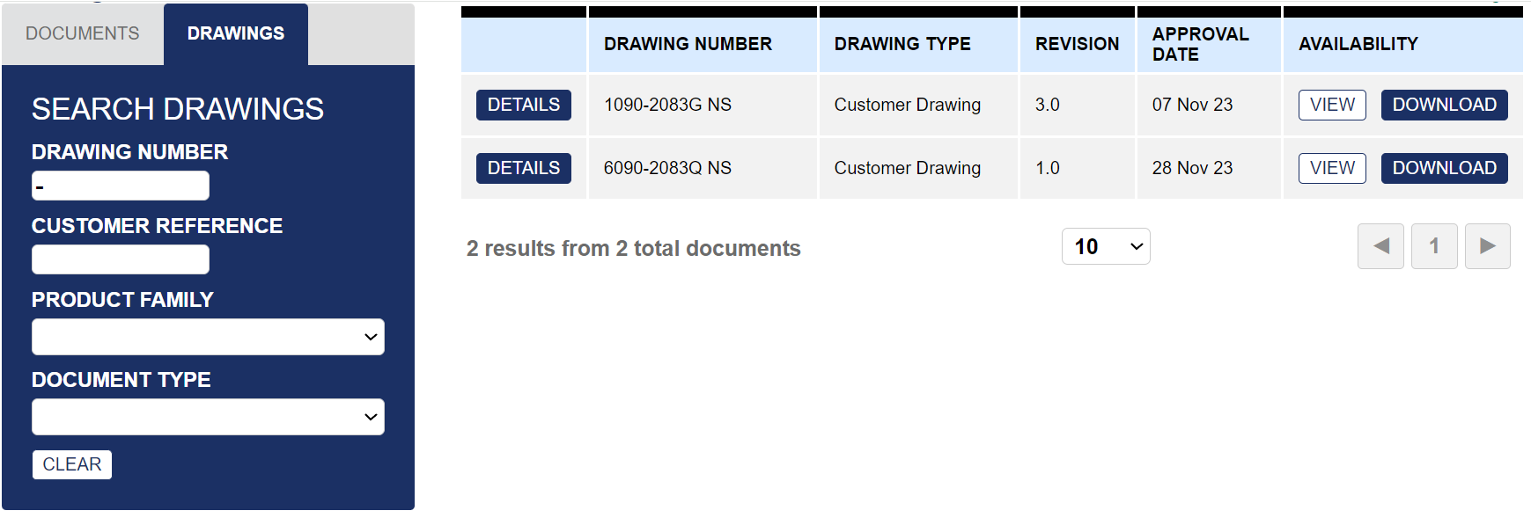
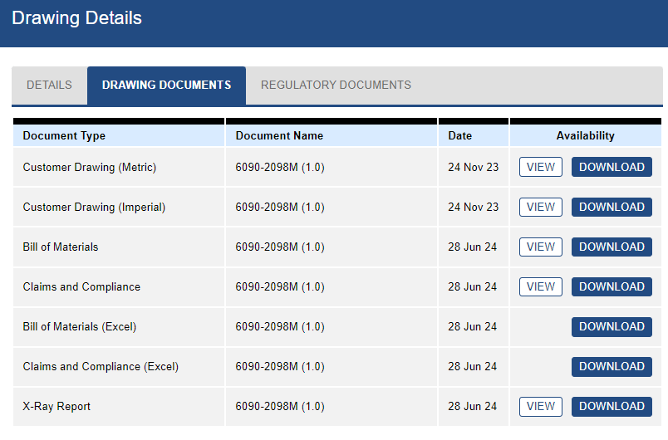
Drawing module in the Accelerator documentation center –drawing details
Select ‘Details’ and then
‘Drawing documents’ tab
to access various drawing documents
in PDF or Excel formats,
available to view and/or download.

Slide 37
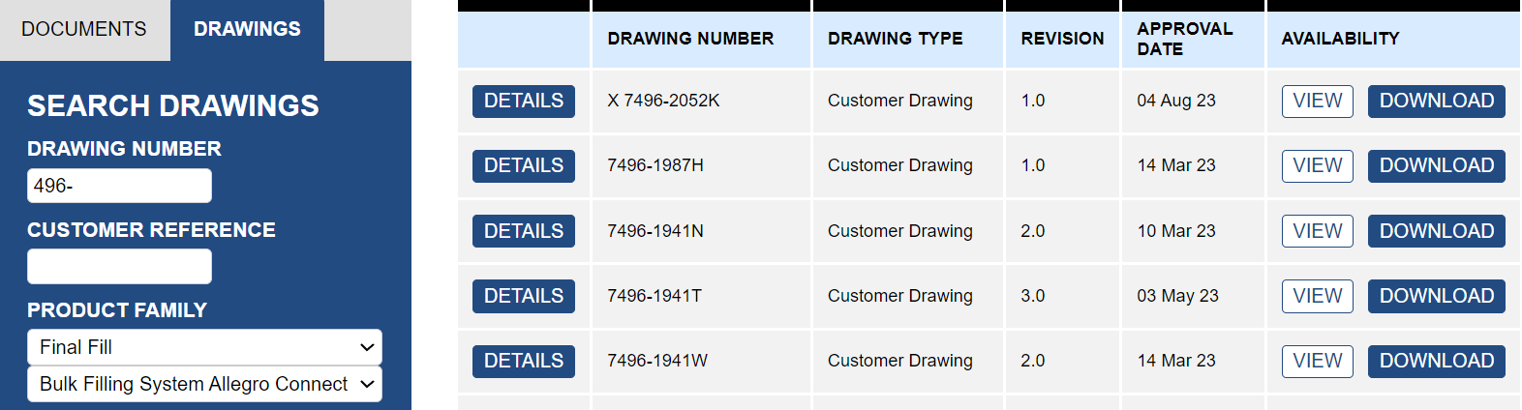
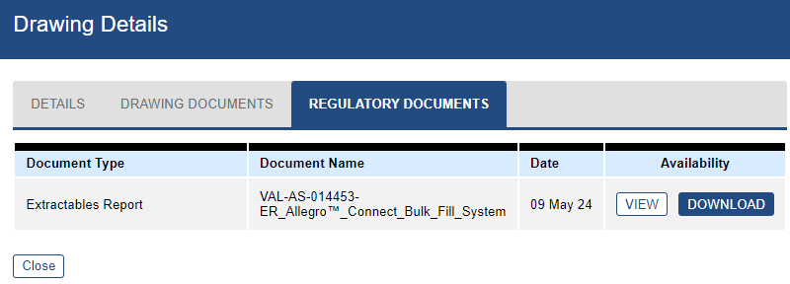
Drawing module in the Accelerator documentation center –regulatory documentation
Product-specific documentation is available under the
‘Regulatory documentation’ tab for a drawing.
This shows documentation linked to a specific drawing product line.
Notes:
One final way customers can access documentation is via the regulatory document tab.

Slide 38
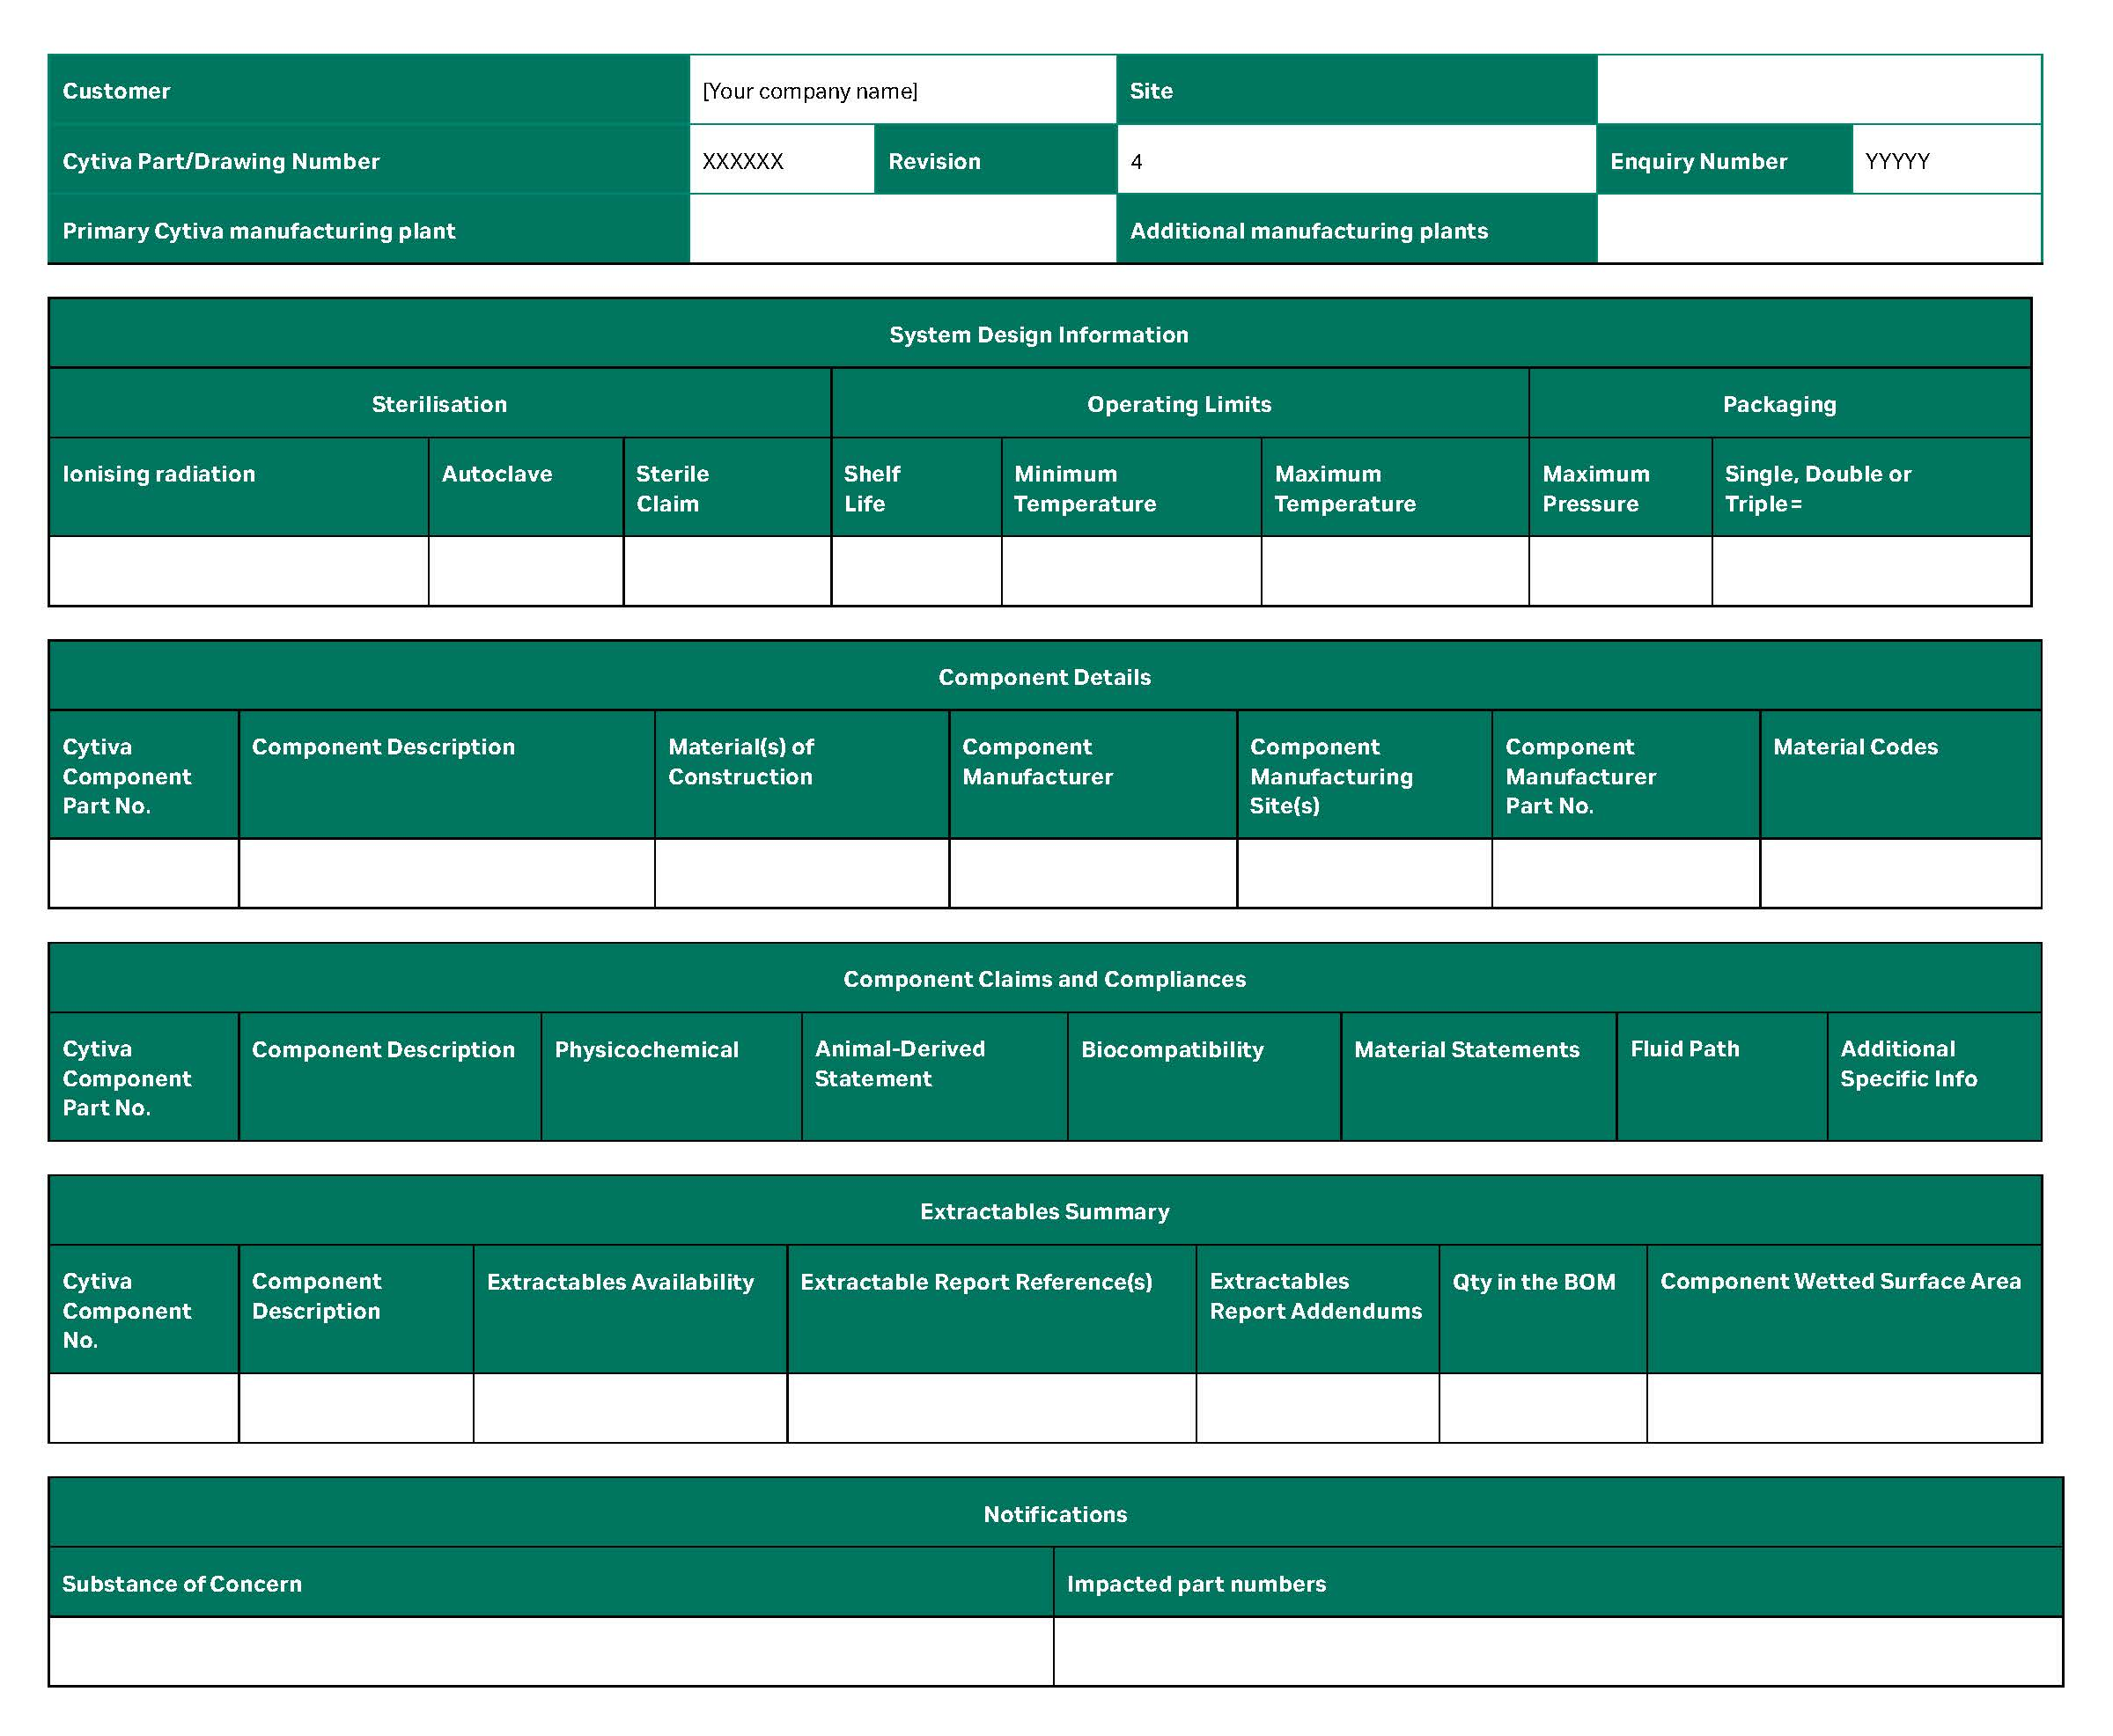
Claims and compliance reports in the Accelerator documentation center
Introduction page of claims and compliance report.
General drawing details, including the Cytiva primary/additional manufacturing sites.
System design information, such as pressure, shelf life.
Component details such as material of construction, Cytiva resin code, wetted surface area etc.
Where designs contain Cytiva-manufactured chambers, sub/ancillary component data is listed.
Component and sub-component claims and compliances.
Extractables summary.
Notification table of components
containing substances of concern.
Definition table at end of report.

Slide 39
www.cytiva.com
Cytiva , and the Drop logo are trademarks of Life Sciences IP Holdings Corporation or an affiliate doing business as Cytiva.
Accelerator, Allegro, Biacore, Hyclone and ReadyToProcess are trademarks of Global Life Sciences Solutions USA LLC or an affiliate doing business as Cytiva.
Any other trademarks are the property of their respective owners.
The Danaher trademark is a proprietary mark of Danaher Corporation.
© 2026 Cytiva
For local office contact information, visit cytiva.com/contact
CY54837-16FEB26-PP

